Slide 1
CLUSTERING OF CATEGORICAL DATA USING ENTROPY BASED K MODE ALGORITHM
PROJECT MENTOR PROJECT MEMBERS:-
Ms. JUHI SINGH MAYANK TAGRA (06310403114)
SAGAR JHA (06210403114)
KARAN CHOPRA (05710403114)
VIVEK KHANDELWAL (05610403114)

Slide 2
CATEGORICAL DATA
Categorical data is the statistical data type consisting of categorical variables or of data that has been converted into that form for example as grouped data.
Categorical variables represent types of data which may be divided into groups. Examples of categorical variables are race, sex, age group, and educational level, it is often more informative to categorize such variables into a relatively small number of groups.

Slide 3
WHAT IS CLUSTERING?
Cluster is a group of objects that belongs to the same class. In other words, similar objects are grouped in one cluster and dissimilar objects are grouped in another cluster.
Clustering is the process of making a group of abstract objects into classes of similar objects.
Clustering helps in classifying documents on the web for information discovery.
Clustering is used in outlier detection applications such as detection of credit card fraud.

Slide 4
BASE PAPER
“An entropy-based subspace clustering algorithm for categorical data.”
Joes Luis Carbonera,Mara Abel ,IEEE 26th International Conference on Tools with Artificial Intelligence,2014,p.p 272-277.

Slide 5
K-MEANS CLUSTERING
K-means clustering is used when you have unlabeled data (i.e., data without defined categories or groups).
The goal of this algorithm is to find groups in the data, with the number of groups represented by the variable K.
The algorithm works iteratively to assign each data point to one of K groups based on the features that are provided.
Advantages:-
Fast, robust and easier to understand.
Gives best result when data set are distinct or well separated from each other.
If variables are huge, then K-Means most of the times computationally faster.
Holds true results even if some assumptions are false.
Disadvantages:-
Some assumptions have to made.
Algorithm fails for non-linear data set.
Applicable only when mean is defined i.e. fails for categorical data.
Only applicable for numeric data.

Slide 6

ALGORITHM OF K-MEANS
Let X = {x₁,x₂,x₃,……..,x_{n}} be the set of data points and V = {v₁,v₂,…….,v_{c}} be the set of centers.
1) Randomly select ‘c’ cluster centers.
2) Calculate the distance between each data point and cluster centers.
3) Assign the data point to the cluster center whose distance from the cluster center is minimum of all the cluster centers.
4) Recalculate the new cluster center using:
where, ‘c_{i}’ represents the number of data points in i^{th} cluster.
5) Recalculate the distance between each data point and new obtained cluster centers.
6) If no data point was reassigned then stop, otherwise repeat from step 3).

Slide 7
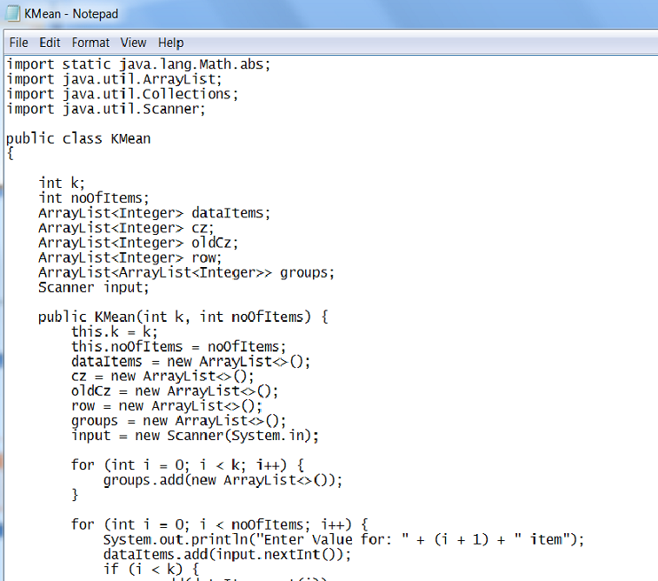
CODE

Slide 8
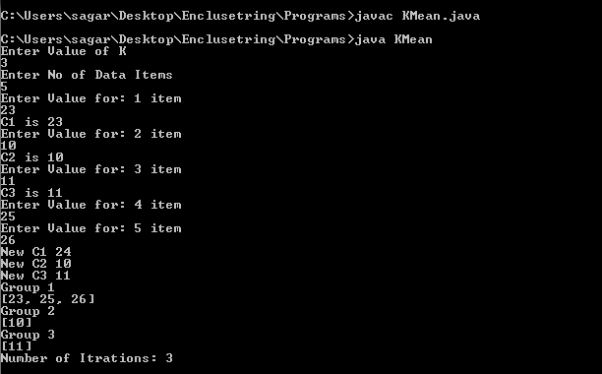
OUTPUT

Slide 9
K-MODE
Extension of K-means
It works on numeric as well as non numeric values.
Frequency based methods are used for clustering of objects.
Replaces the means of clusters with modes.
Uses simple matching dissimilarity measure for categorial data.

Slide 10
K-mode algorithm
1.Generate K clusters by arbitrarily selecting data objects and choose K initial cluster center, one for every of the cluster.
2.Assign data object to the cluster whose cluster center is near toward it .
3.Update the K cluster base on allocation of data objects plus calculate K latest modes of every one clusters.
4.Repeat step 2 to 3 awaiting no data object has changed cluster relationship otherwise some additional predefined criterion is fulfill.

Slide 11
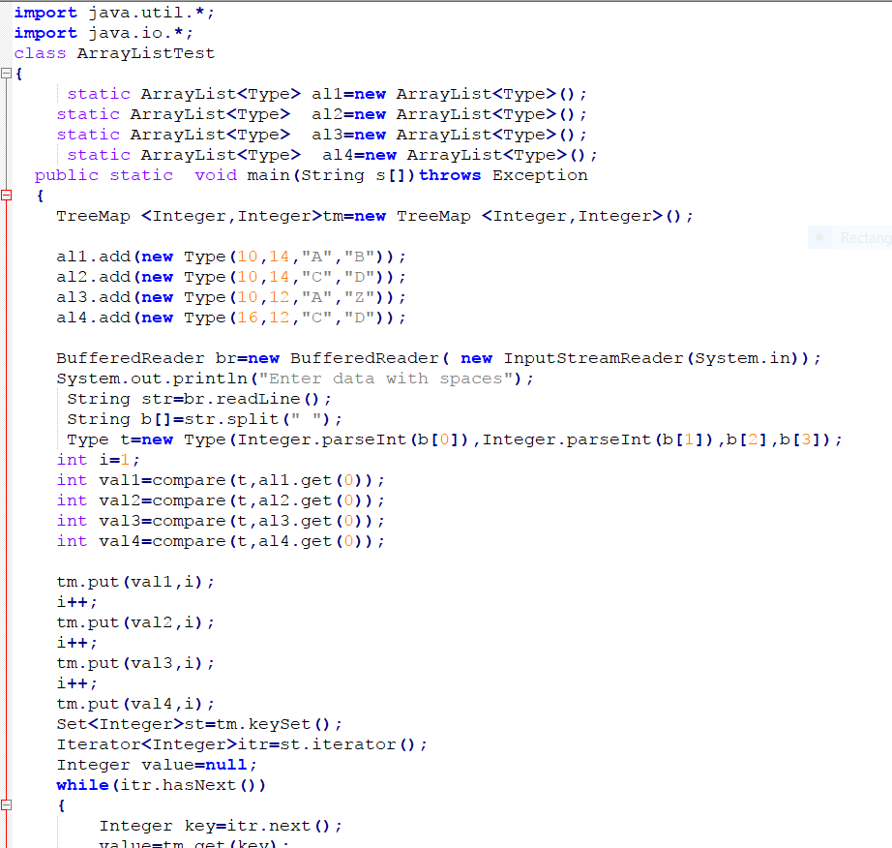
Code

Slide 12
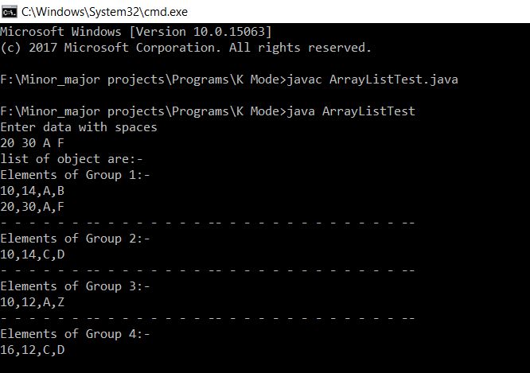
OUTPUT

Slide 13
CHALLENGES
Categorical data sets are often high-dimensional.
The dissimilarity between a given object x and its nearest object will be close to the dissimilarity between x and its farthest object.
Discovering meaningful separable clusters becomes a very challenging task.

Slide 14
EBK-modes: Entropy Based K-Modes.
Soft subspace clustering algorithm.
For handling the high-dimensionality, some works take advantage of the fact that clusters usually occur in a subspace defined by a subset of the initially selected attributes.
Extends the basic k-modes algorithm.
Measures the contribution of each attribute using the notion of entropy.
In Information Theory, entropy is a measure of the uncertainty in a random variable.
The larger the entropy of a given random variable, the larger is the uncertainty associated to it.

Slide 15
ENTROPY
Considering a finite sample, the entropy H of a given variable X can be written as:
H(X)=-∑P(X_{i})log(P(X_{i}))
where P(X_{i}) is the probability mass function

Slide 16
NUMERICAL EXAMPLE ON EBK MODE
Let us consider the following cluster c1.
Its center is given by the mode of each attribute:
z1=(d,k,n,r,s)
DATA OBJECT | A1 | A2 | A3 | A4 | A5
X1 | a | k | n | q | s
X2 | b | k | n | r | s
X3 | c | k | n | q | s
X4 | d | k | o | r | t

Slide 17
APPROACH FOR ATTRIBUTE WEIGHTING
Let us consider a_{h}^{(l)} as the most frequently occurring value (the mode) of the attribute l, for a cluster ci.
The value zij induces a subset ci’ of ci, which is the set of all objects in ci that have zij as value for the attribute j.
This is represented by the function φi(zij).
Maps a given categorical value ,which contains every object in the partition ci ∈ C.
For example φ₁(s) = {x₁,x₂,x₃}
The set of objects that have the value s (for the attribute a₅).
Data object | A1 | A2 | A3 | A4 | A5
X1 | a | k | n | q | s
X2 | b | k | n | r | s
X3 | c | k | n | q | s
X4 | d | k | o | r | t

Slide 18
𝞧(a_{h}^{(l)},a_{j}^{(p)})
A function that maps two given categorical values a_{h}^{(l)}∈ dom(a_{h}) and a_{j}^{(p)}∈ dom(a_{j}) to the number of objects, in ci ∈ C
For example : ψ1(s,q)=|{x1,x3}| =2 .
α(a_{h}^{(l)},a_{j})
Maps a given categorical value and a given attribute
For example : α1(s,a1)={a,b,c}

Slide 19

We can measure the entropy of any attribute a_{i}, considering the set induced by φ_{i}(z_{ij}). This is measured through a function E_{i}(z_{ij},a_{i}).
Data object | A1 | A2 | A3 | A4 | A5
X1 | a | k | n | q | s
X2 | b | k | n | r | s
X3 | c | k | n | q | s
X4 | d | k | o | r | t
For example-
ε1(s,a1)= −𝟏/𝟑𝒍𝒐𝒈𝟏/𝟑+𝟏/𝟑𝒍𝒐𝒈𝟏/𝟑+𝟏/𝟑𝒍𝒐𝒈𝟏/𝟑=𝟏.𝟏𝟎
ε1(s,a3)= −𝟑/𝟑𝒍𝒐𝒈𝟑/𝟑=𝟎

Slide 20

The average of the uncertainty that is projected to a given attribute a_{h}, considering the modes of all attributes, in a partition ci.
This is measured through a function:
where |A| is the number of attributes
FOR EXAMPLE:
E1(d,a5) = 0
E1(k,a5) = 0.56
E1(n,a5) = 0 E1(a5)= [0+0.56+0+0.69+0]/5= 0.25
E1(r,a5) = 0.69
E1(s,a5) = 0

Slide 21
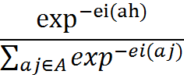
ENTROPY-BASED RELEVANCE INDEX (ERI)
It is inversely proportional to the E𝒊(ah), i.e., the average of the uncertainty that is projected to a given attribute ah, considering the modes of all attributes, in a partition ci.
ERI_{i}(a_{h})=

Slide 22

DISSIMILARITY FUNCTION
EBK-modes adopts a function d that computes the dissimilarity between an object x_{i} and a cluster mode z_{l}.
𝑑(x_{i}, z_{l})= 𝑎𝑗(x_{i}, z_{l} )
where
𝜃𝑎𝑗(x_{i}, z_{l} )= 1 , X_{ij} ≠ Z_{ij}
1−𝐸𝑅𝐼𝑎𝑗 , X_{ij} = Z_{ij}

Slide 23
ALGORITHM
INPUT: We have a set of data objects and number of clusters.
Firstly we will randomly choose K distinct objects from given set of data objects and assign them to the NewNodes.
Till the point OldNodes≠NewNodes
For Every data object and for every cluster we will calculate:
Dissimilarity between the i-th data object and the l-th mode and classify the i-th data object into the cluster whose mode is nearest to it.
For every Cluster
Calculate the mode Z_{l} of each cluster and assign to the NewNodes
Calculate weight of each attribute a_{h} ∈ A of the l-th Cluster using ERI(a_{h} ).
OUTPUT: All the data objects are partitioned into k Clusters.

Slide 24
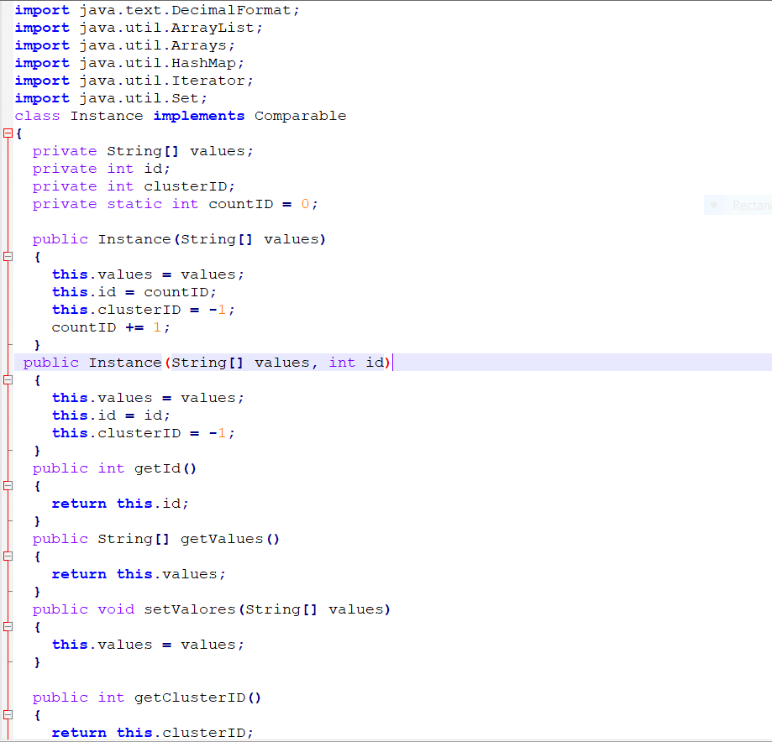
CODE

Slide 25
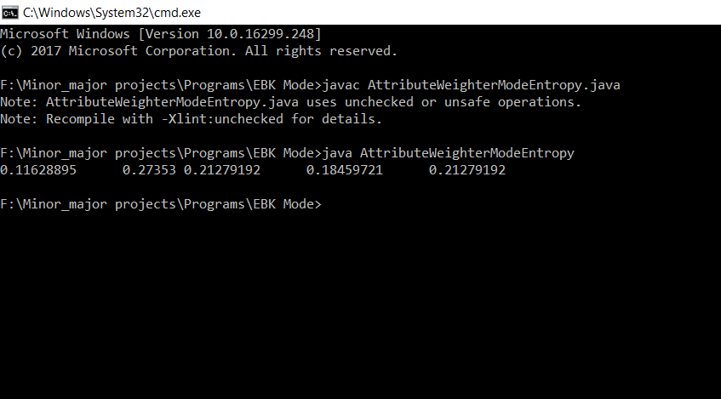
OUTPUT

Slide 26
CONCLUSIONS OF EBK FOR CATEGORICAL DATA
We propose a subspace clustering algorithm for categorical data called EBK-modes.
It modifies the basic k-modes by considering the entropy-based relevance index (ERI) as a measure of the relevance of each attribute in each cluster.
The ERI of a given attribute is inversely proportional to the average of the entropy projected to this attribute for each attribute value of the mode of a cluster.
Our experiments have shown that the EBK-modes has a performance that is comparable to the performance of the state-of-the-art algorithms.

Slide 27
PROPOSED WORK
We will implement EBK for mixed data set.
Mixed data – It is a type of data which has both numerical as well as categorical data like string.
EBK[mixed data]= EBK[numerical data] + EBK[categorical data]
Example of mixed data:-
A | 8 | E | 4 | G | 9

Slide 28
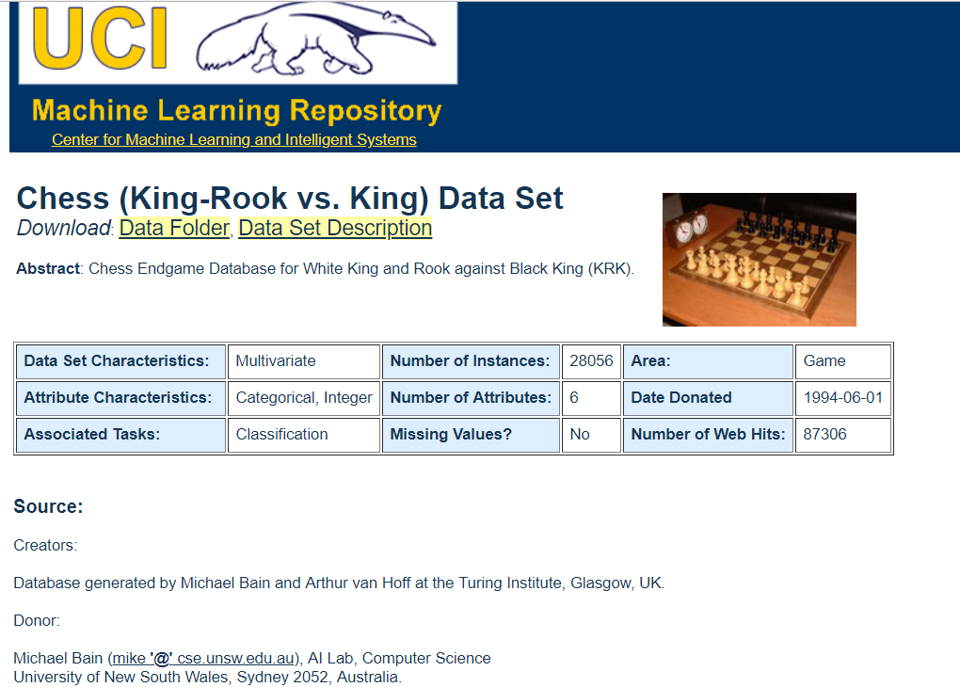
DATA This data set has been taken form the UCI-Machine learning repository[7]

Slide 29
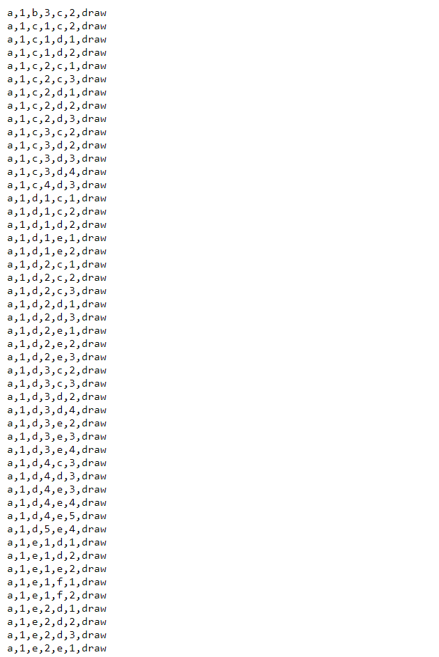

Slide 30
ALGORITHM
First we will declare object group’ items.
if(next element is a string)
{
{ store value in object group 1}
else
{ store value in item 1}
for each( row of object group 1)
{ execute with item 1 of next row of object group 1}
Calculate distance using dissimilarity function.
Display result 1
}
Else
{
if(object group of numerical value)
{ store values in object group 2}
else { store values in item 2}
for each (row of object group 2)
{execute with item 1 of next row of object group 1}
Calculate distance using distance function
Display result 2
Add result 1 and result 2
Store it in final result
Select minimum of final result
Put item in object group

Slide 31
start
declare obj group and item
next element is string?
false
If obj grp numeric value
true
false
false
true
Store numeric value in item2
true
If string of obj group?
Declare item of string value
Store numeric value in obj2
Declare obj group 1 of string
false
Obj remaining in objgrp2
true
Claculate dissimilarity of item2 with next row of objgrp2 using distance function
obj remaini-ng in obj1
true
execute item1 & next row of objgrp1
false
end
end
Display results numeric data

Slide 32
Item1’s xij=yij of objgrp1?
false
true
Return 1
Return 1-λij
Display result string data
Add both results
Display and check the lower value of final result
Send the item to data obj which has lower value
end

Slide 33
REFERENCES
[1J OES LUIS CARBONERA, MARA ABEL,” An entropy-based subspace clustering algorithm for categorical data”, IEEE 26th International Conference on Tools with Artificial Intelligence,2014,p.p 272-277.
[2 ]D. Barbar´a, Y. Li, and J. Couto, “Coolcat: an entropybased algorithm for categorical clustering,” in Proceedings of the eleventh international conference on Information and knowledge management. ACM, 2002, pp. 582–589.
[ 3] P. Andritsos and P. Tsaparas, “Categorical data clustering,” in Encyclopedia of Machine Learning. Springer, 2010, pp. 154–159.
[ 4] J. L. Carbonera and M. Abel, “Categorical data clustering:a correlation-based approach for unsupervised attribute weighting,” in Proceedings of ICTAI , 2014.
[5 ] L. Bai, J. Liang, C. Dang, and F. Cao, “A novel attribute weighting algorithm for clustering high-dimensional categoricaldata,” Pattern Recognition,vol. 44,no. 12,2011,pp. 2843–2861.
[6 ] G. Gan and J. Wu, “Subspace clustering for high dimensional categorical data,” ACM SIGKDD Explorat. ACM, 2002, pp. 582–589.
[ 7] Data Set : Ucimachinelearning.Org.

Slide 34
THANK YOU

